Slide 1
Contact Center Flex Plan
Deal Construction, Pricing and Discounting
Kevin McPartlan Rich Wilkins
CCBU Offers Team
April 2023

Slide 2

Agenda
1
CC Flex Overview
2
Pricing and Discounting
3
Configuring CC Flex Deals
4
Types of Deals
5
Order is Booked – What’s Left?

Slide 3
CC Flex Overview

Slide 4

Why
Flex?

Slide 5
Perpetual Licenses – The Costco Model
Buy features in advance to get a better deal
Payment required in advance
Buy for peak concurrent usage
Keep maintenance to retain license rights
No seasonal licenses or bursting
No ability to mix license tiers
Limited to a single contact center platform
Innovations require software upgrades
Moving to a new platform is a re-buy
FEATURES

Slide 6
Contact Center
Flex Plan 3.0 Specifics
Cloud Contact Center
Webex Contact Center
Webex Contact Center Enterprise
Same Flex Benefits
Ability to move to cloud over time or all at once
Ability to mix Standard and Premium Agents
Support for customer’s existing on-premises platform for up to 18 months
Single subscription for all agents
Consistent feature sets across platforms
Extensible with cloud innovations
Flexible term lengths and payment options
Ability to grow via seasonal usage
On-Premises Contact Center
Contact Center Express¹
Contact Center Enterprise
Details
New ATO: A-FLEX-3-CC
New offer packaging
New price
New discount structure
Does not include:
Hosted (CCE/CCX)
WxCCE Add-Ons²
¹ Offer stays the same
² Replace with Solutions+

Slide 7
Cloud Contact Center Options
Webex Contact Center / Webex Contact Center Enterprise
 | CC Flex Standard Agent Features | CC Flex Premium Agent Features
Positioning | Leading offer “Things a customer needs” | High value “Things a customer wants”
Features¹ | Inbound voice IVR port Preview outbound New: chat & email (agent assisted) New: Journey Data Services¹ New: Elements of Webex XM¹ New: Webex Connect (self-service channels) | All in Standard plus SMS, WhatsApp, Facebook Messenger (agent assisted) Predictive & Progressive Dialer¹ Supervisor features Future*: Smart Audio (BabbleLabs) ¹ Future*: Apple Bus Chat, Twitter, others¹
List Price | WXCC: $115 Concurrent, $85 Named WXCCE: $155 Concurrent | WXCC: $170 Concurrent, $130 Named WXCCE: $235 Concurrent
¹ Please refer to product roadmaps for availability of new features
*Draft – Future still in definition
Subject to fair use, some elements may come with additional charge, inclusions may vary by region

Slide 8
On-premises Contact Center Options
Contact Center Enterprise(Unified / Packaged)/Contact Center Express
 | CC Flex Standard Agent Features | CC Flex Premium Agent Features
Positioning | Leading offer “Things a customer needs” | High value “Things a customer wants”
Contact Center Enterprise (Unified / Packaged) Features | Inbound voice IVR port Preview outbound New: Journey Data Services¹ New: Webex Connect (self-service channels) | All in Standard plus Chat & email (agent assisted)¹ Predictive & Progressive Dialer Supervisor features Future Offerings*
Contact Center Express Features | Inbound Voice IVR port Basic outbound | All in Standard plus Chat & email (agent assisted) Predictive & Progressive Dialer Supervisor features
List Price | $38 Concurrent | $53 Concurrent
¹ Please refer to product roadmaps for availability of new features
*Draft – Future still in definition
Subject to fair use, some elements may come with additional charge, inclusions may vary by region

Slide 9



New discount structure
More discount when you add more value.
Get higher discounts with:
Longer term subscriptions
Higher quantity licenses
More add-ons
Tiered Discount based on Dollar Threshold met on extended list price of committed agents/ports and Webex WFO.
$500,000+
49%
Tier 3
$100,000+
44%
Tier 2
$20,000+
40%
Tier 1
37%
Notes:
Speak to the funnel

Slide 10
Pricing and Discounting

Slide 11
List Price - Cloud
Note: All overage SKUs have the SAME list price
as committed SKUs – a decrease of 50%+ for those SKUs
Platform | SKU Type | Previous List Price | New List Price | % Delta
Webex Contact Center | Standard Named | $100 | $85 | -15%
 | Premium Named | $130 | $130 | 0%
 | Additional IVR Port | $70 | $70 | 0%
 | Standard Concurrent | $130 | $115 | -12%
 | Premium Concurrent | $170 | $170 | 0%
 | Additional IVR Port | $70 | $70 | 0%
Webex Contact Center Enterprise | Standard Concurrent | $175 | $155 | -11%
 | Premium Concurrent | $235 | $235 | 0%
 | Additional IVR Port | $85 | $70 | -18%
Webex WFO | Call Recording | $5 | $10 | 100%
Webex WFO | Quality Management* | $35 | $41 | 17%
 | Workforce Management* | $39.50 | $39.50 | 0%
 | Analytics | $50 | $58 | 16%
 | Analytics with Transcription* | $60 | $69 | 15%
 | Suite Bundle | $100 | $125** | 25%
 | Real Time & Archive Storage (per Gb) | $0.03 | $0.03 | 0%
*Included in Suite Bundle
**Includes implementation services

Slide 12
List Price – On-Premises
Platform | SKU Type | Previous List Price | New List Price | % Delta
Unified Contact Center Enterprise | Standard Concurrent | $45 | $38 | -16%
 | Premium Concurrent | $60 | $53 | -12%
 | Additional IVR Port | $20 | $20 | 0%
Packaged Contact Center Enterprise | Standard Concurrent | $45 | $38 | -16%
 | Premium Concurrent | $60 | $53 | -12%
 | Additional IVR Port | $20 | $20 | 0%
Unified Contact Center Express | Standard Concurrent | $45 | $38 | -16%
 | Premium Concurrent | $60 | $53 | -12%
 | Additional IVR Port | N/A | N/A | N/A

Slide 13

Add-ons
Full list of add-ons and descriptions will be available at offer launch. Solutions+ offerings are also available separately.
Add-on | Included | Paid
Webex Workforce Optimization |  | X
PSTN (USA and Canada only) |  | X
Google CCAI |  | X
Campaign Management |  | X
Digital Channels | X | X
Journey Data Service | X

Slide 14
Discount structure
Contact Center Flex 3.0 – Region 1 (USA, Canada, Japan)
Agents and Ports SKUs
Tier# | Extended List Price Minimum | Market | Advantage Pricing (OIP/TIP) | Flex 3 CC Reseller (R1) | Total Discount Region 1
0 | No commitment | 20% | 10% | 7% | 37%
1 | $20K |  |  | 10% | 40%
2 | $100K |  |  | 14% | 44%
3 | $500K+ |  |  | 19% | 49%
Webex WFO SKUs
Tier# | Extended List Price Minimum | Market | Advantage Pricing (OIP/TIP) | Flex 3 CC Reseller (R1) | Total Discount Region 1
0 | No commitment | 20% | 0% | 0% | 20%
1 | $20K |  |  | 5% | 25%
2 | $100K |  |  | 10% | 30%
3 | $500K+ |  |  | 15% | 35%
Extended List Price qualifying elements could include Premium and/or Standard Agents, IVR Ports, WFO.

Slide 15
Discount structure
Contact Center Flex 3.0 – Region 2 (Rest of World) +5%
Agent and Ports SKUs
Tier # | Extended List Price Minimum | Market | Advantage Pricing (OIP/TIP) | Flex 3 CC Reseller (R2) | Total Discount Region 2
0 | No commitment | 20% | 10% | 12% | 42%
1 | $20K |  |  | 15% | 45%
2 | $100K |  |  | 19% | 49%
3 | $500K+ |  |  | 24% | 54%
Webex WFO SKUs
Tier # | Extended List Price Minimum | Market | Advantage Pricing (OIP/TIP) | Flex 3 CC Reseller (R2) | Total Discount Region 2
0 | No commitment | 20% | 0% | 0% | 20%
1 | $20K |  |  | 5% | 25%
2 | $100K |  |  | 10% | 30%
3 | $500K+ |  |  | 15% | 35%
Extended List Price qualifying elements could include Premium and/or Standard Agents, IVR Ports, WFO.

Slide 16
Configuring CC Flex Deals

Slide 17
Deal Components Flex 3.0 Contact Center
Agents and Ports
Additional Options
Support and Solutions Plus
Term and Requested Start Date
Agents and ports are all “committed” usage and cloud platforms offer overage SKUs
Agents and ports are configured per platform (Webex CC, Webex CCE, UCCX, UCCE, PCCE)
Webex CC offers Named Agent and Concurrent Agent buying models (start with Named!)
Get the right mix of Standard and Premium Agents based on user feature requirements – mixing allowed!
These are at additional cost but supported by Cisco
Some are committed – Webex WFO, Campaign Management and PSTN
Some are usage-based – CCAI, Digital Channels (numbers and messages)
Note: Not all add-ons are supported for all platforms (check datasheets)
Term determines length of the subscription commit for the customer and partner
Requested Start Date determines when the order is provisioned
Requested Start Date also affects the SWSS residual
Auto-renew defaults to “on” and renewal term defaults to 12 months
Solution Support is default; Basic is for specialized partners
Solution Support and Premium support also available
Solutions Plus sold by Cisco (outside A-FLEX-CC)
Solutions Plus supported by Solutions Plus partner

Slide 18
Contact Center Flex Plan Agents and Ports
UCCX / UCCE / PCCE
Premium
Premium
Webex Contact Center
Premium
A-FLEX-CC
A-FLEX-3-CC
Flex Contact Center Agents
Webex Contact Center Enterprise
Premium
Mixing allowed
UCCX / UCCE / PCCE
Standard
Standard
Webex Contact Center
Standard
Webex Contact Center Enterprise
Standard
Notes:
Mention no named agent buying model
No EA buying model for CC Flex

Slide 19
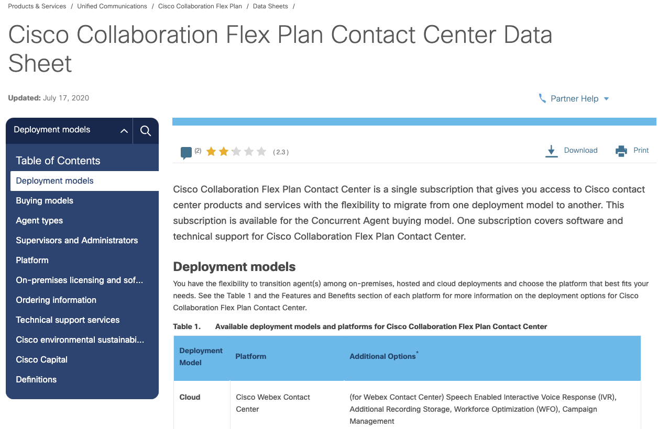
What should you be asking your customer
Are you ready to move to the cloud?
Do I need Standard or Premium?
Do I need add-ons?
What about my on-premise WFO?
How many IVR Ports do I get?
Details available in the data sheet.

Slide 20
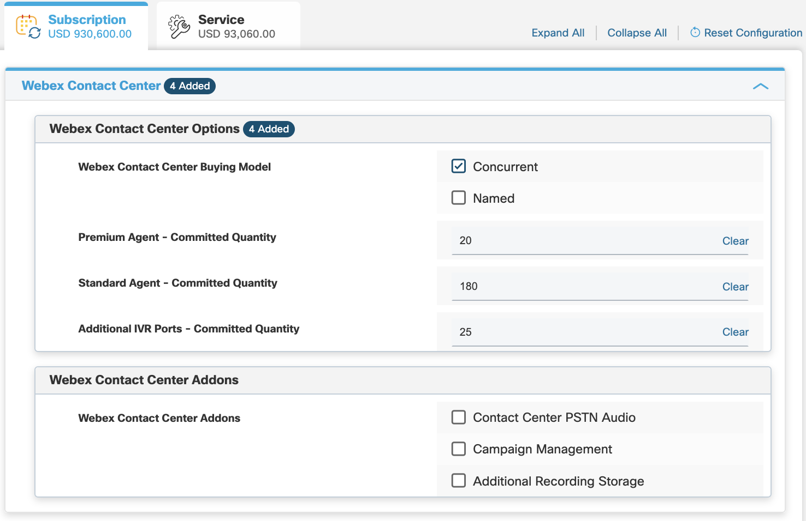
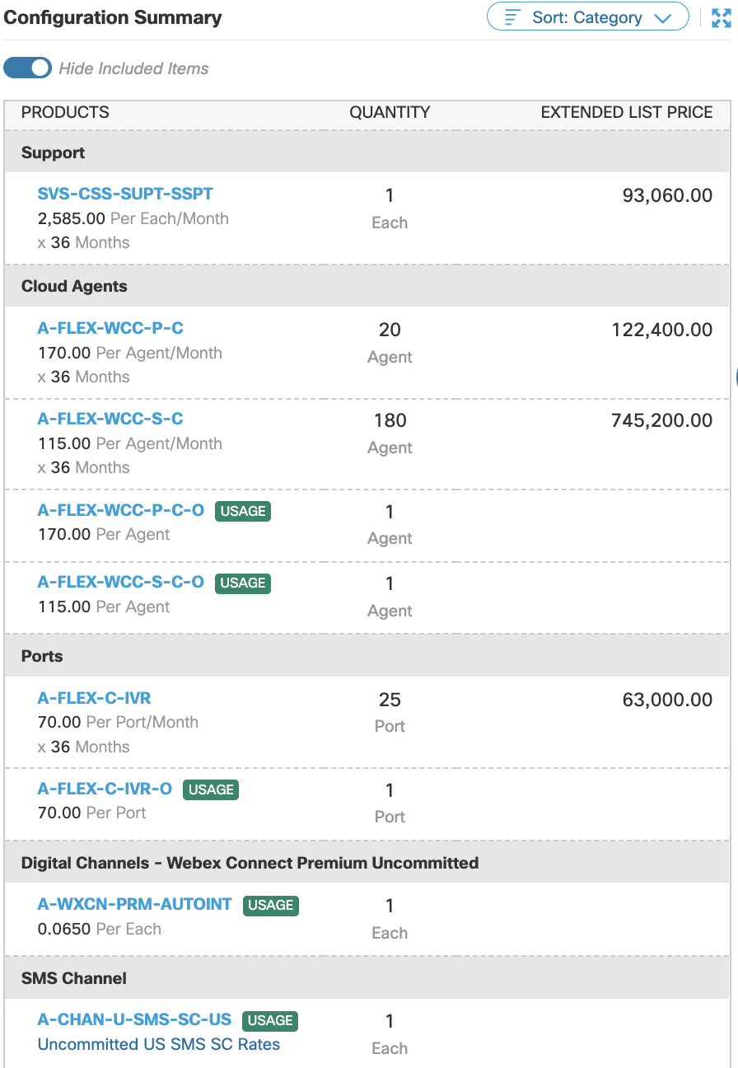
A-FLEX-3-CC Agents and Ports and Usage SKUs
Committed
Overage

Slide 21
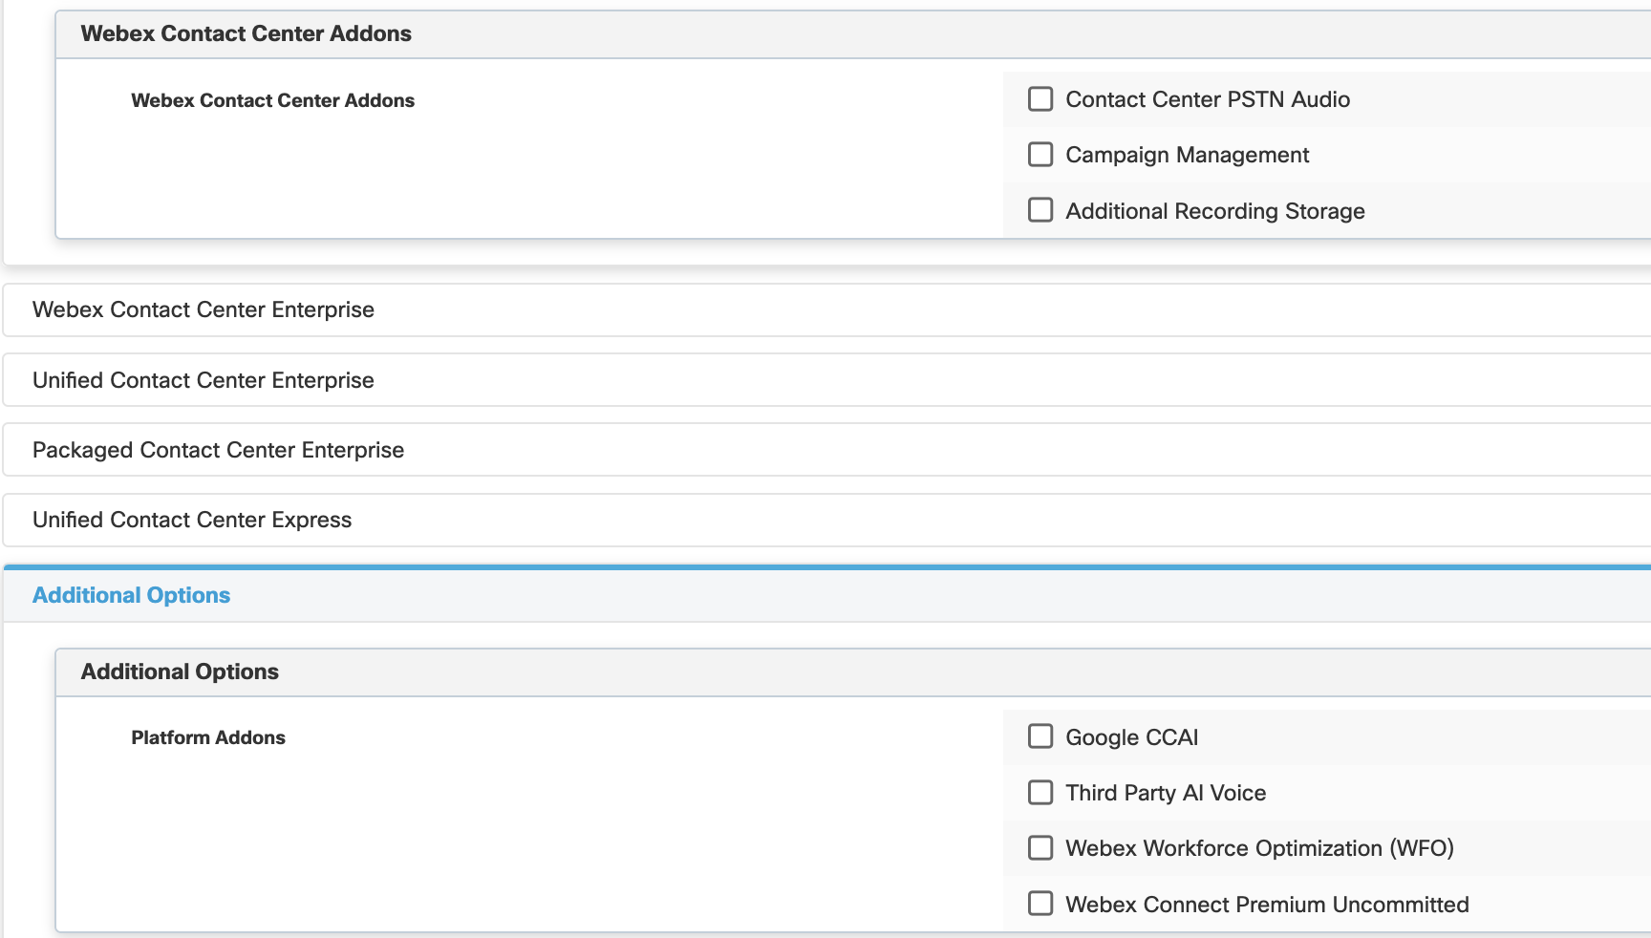
A-FLEX-3-CC Addons and Additional Options
Available Addons
Campaign Management
Webex WFO
Call Recording*
QM
WFM
WFM2
Transcription
WFO Bundle
CCAI
Dialogflow ES
Dialogflow CX
PSTN
Toll Inbound
Toll-free Inbound
Solutions Plus sold separately
* Native recording included for Webex CC
Notes:
Talk about platform differences for features and data sheet
1:1 agents to IVR for CCE/PCCE/HCS-CCE
2:1 IVR to agents for CCX
Extra IVR ports available for CCE but not for CCX (must buy more agents)
Dialer ports included in CCE and PCCE

Slide 22
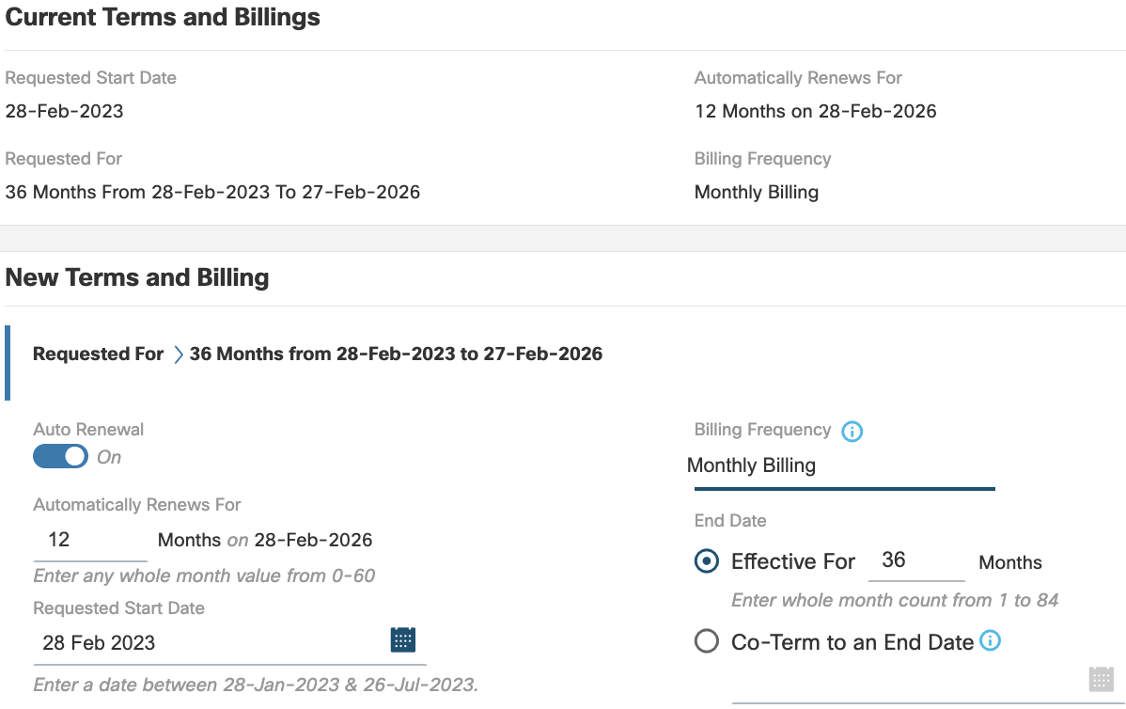
A-FLEX-3-CC Terms and Billing
Notes:
Talk about platform differences for features and data sheet
1:1 agents to IVR for CCE/PCCE/HCS-CCE
2:1 IVR to agents for CCX
Extra IVR ports available for CCE but not for CCX (must buy more agents)
Dialer ports included in CCE and PCCE

Slide 23
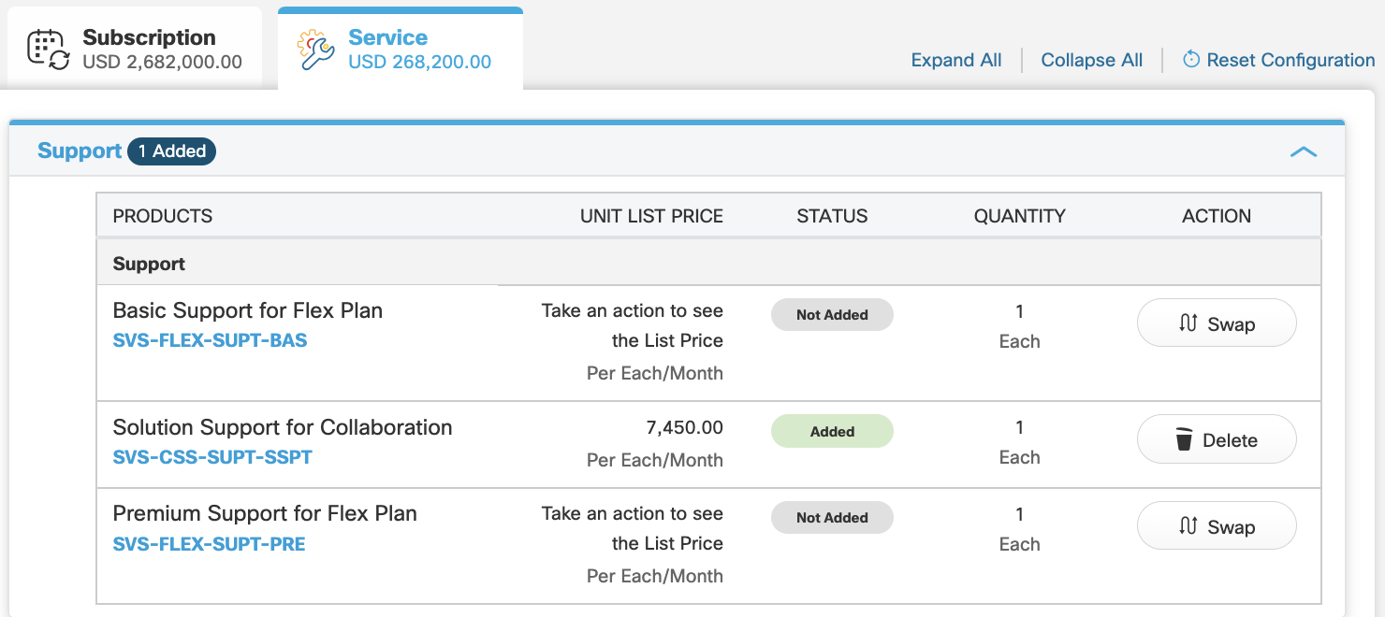
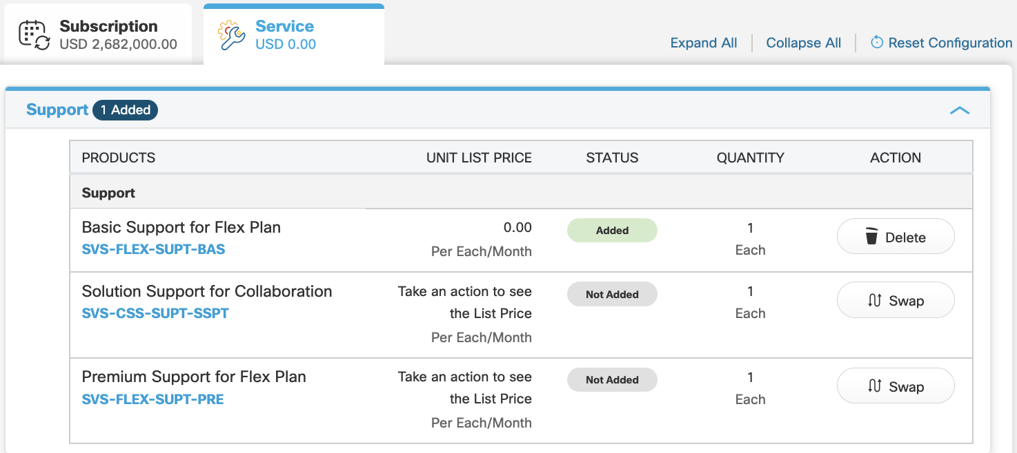
A-FLEX-3-CC Support Options
Default option
required for non-specialized partners
Recommended for
Specialized partners

Slide 24
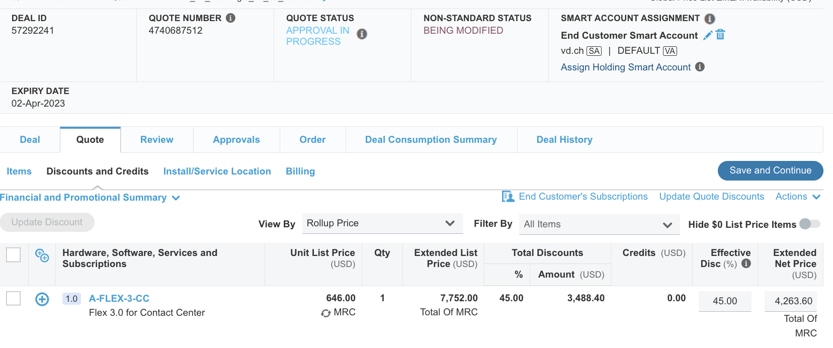
Smart Accounts & Virtual Accounts
Smart Account - Provides a central location to manage software licenses and entitlements across your entire organization
Virtual Account – Subset of Smart account, allows customers to organize licenses across internal groups/departments
Notes:
Smart Accounts in CCW - User Guide: https://www.cisco.com/E-Learning/gbo-ccw/cdc_bulk/Cisco_Commerce_Core_Curriculum/Cisco_Commerce_Smart_Accounts_User_Guide.pdf

Slide 25

Use Credits vs. Additional Discount Discount is FOREVER!!!
SWSS Residual Credits – available for customers who have active SWSS contracts, to incentivize their migration.
Contact Center SWSS to Flex Migration – available for by exception request, when flex pricing is a migration blocker, applied across each month for subscription term.
Time Bound SWSS Residual Manual Addition Flex – available for by exception request, applied to standard and premium agents for the first N months of a subscription.
Win with Webex – available for by exception request, when up against a competitor (e.g. Avaya, Genesys)

Slide 26
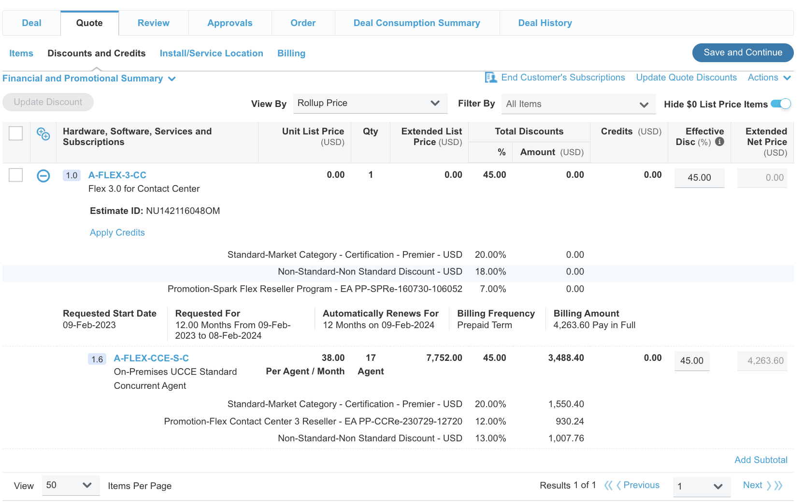
A-FLEX-3-CC Pricing and Discounting Quiz
Why was this deal rejected?
There are no Premium Agents
The deal has non-standard discounts instead of credits
The term is too short
Both a and b
Both b and c

Slide 27
Types of Deals

Slide 28
Time for Cloud?
Think cloud – start with named agents
Understand all current operating costs
Compute, labor, data center, management, etc..
Costs will shift – going to the cloud
Understand the contact center business vs IT dynamic
It is all about unlocking the potential and quantifying it
Digital transformation, empowering agents, customer experience, etc.
Consumption models & flexibility
Webex CC Try and Buy program available – preferred to “seeding”
Don’t forget Webex WFO

Slide 29

Not ready to move to the cloud?
The Contact Center Flex Plan offers a term-based subscription model to increase choices and remove barriers so you can migrate to the cloud at your own pace.

Slide 30
Contact Center SWSS to Flex
Offer on-prem UCCX / UCCE / PCCE customers maintenance on CC Flex vs. SWSS
Best Practice
Review Flex feature list for agent mix – most agents will fit with Flex Standard Agent
Verify the SWSS renewal price by one of the following methods:
Get a SWSS quote from the account team. Ensure the quantities and SKUs match the current order
Get the current contract number from the account team, and looking up the SWSS price/discount in ccrc (if you have access). Sometimes it is difficult to find prices in ccrc. Alternatively find the SWSS order SO
Find the last SWSS order for the customer in the bookings data, and determine the SWSS discount for that order.
Hard to match for:
Previous large discount on SWSS
100% premium
CCX Enhanced license SWSS

Slide 31
Customer scenario – Greenfield cloud “RFP for omnichannel agents and all the cloud features”
Original CC Flex
Flex 3 CC
200 agent deal
12-month term
Quote for 100% Premium Flex agents
$408,000 list price
$183,600 at 55% discount
200 Webex WFO bundle
$240,000 list price
$175,200 at 27% discount
Non-standard deal
$358,800 total price
200 agent deal
12-month term
Quote for 20% Premium Flex agents, 80% Standard Flex agents
$302,400 list price
$169,344 at 44% discount (Tier 2)
$154,224 at 49% discount (Tier 3)
200 Webex WFO bundle
$240,000 list price
$156,000 at 35% discount
$310,224 total price

Slide 32
Customer scenario: On-prem to Cloud “CCX/CCE customer looking to migrate to cloud”
Original CC Flex
Flex 3 CC
200 agent deal
36-month term
Quote for 100% Premium Flex agents
$1,224,000 list price
$464,400 at 62.1% discount (55% + VT)
Non-standard deal
$464,400 total price
200 agent deal
36-month term
Quote for 20% Premium Flex agents, 80% Standard Flex agents
$907,200 list price
$462,672 at 49% discount
$462,672 total price

Slide 33
Customer scenario - Renew Maintenance on Flex “No interest in cloud, just need to renew my maintenance”
Original CC Flex
Flex 3 CC
200 agent deal
12-month term
Quote for 100% Premium Flex agents
$144,000 list price
$57,600 at 60% discount
Non-standard deal
$57,600 total price
200 agent deal
12-month term
Quote for 20% Premium Flex agents, 80% Standard Flex agents
$98,400 list price
$59,040 at 40% discount
$59,040 total price

Slide 34
Customer scenario - Renew Maintenance on Flex “No interest in cloud, just need to renew my maintenance, and add 25 agents”
Perpetual licenses and SWSS
Flex 3 CC
200 agent deal
12-month term
Existing SWSS
Assume contract >24 mos. ago with 50% SWSS discount for $35,910 per year
Quote for additional 25 UCCX Premium agents
$58,996.50 license list price $14,719.13 SWSS list price
$36,872.81 net price
$72,782.81 total price
200 agent deal
12-month term
Quote for 20% Premium Flex agents, 80% Standard Flex agents
$98,400 list price
$59,040 at 40% discount
Quote for additional 25 Flex agents (20 Standard + 5 Premium)
$12,300 additional Flex list price
Entire deal now gets 44% discount
$6,888 net price for new agents
$61,992 total price

Slide 35
Customer Scenario Seasonality – Webex CC and Webex CCE
Overage SKUs added to every order
Overage SKUs now same price and discount as committed SKUs
Overage SKUs used for any usage above committed values
Agents
Ports
Webex WFO
Billed in arrears
Additional usage does not increase commit

Slide 36
Customer Scenario Seasonality – On-Premises
No Overage SKUs available
Requires Smart Licensing
Usage reported to Smart License server
System goes into out-of-compliance state if usage is above committed values
Solution is to create a second Flex subscription for short term licenses to get back in compliance
Agents
Ports
Standard Flex billing terms available
Note: Webex WFO *does* have overage SKUs

Slide 37
Usage Based Add-ons

Slide 38
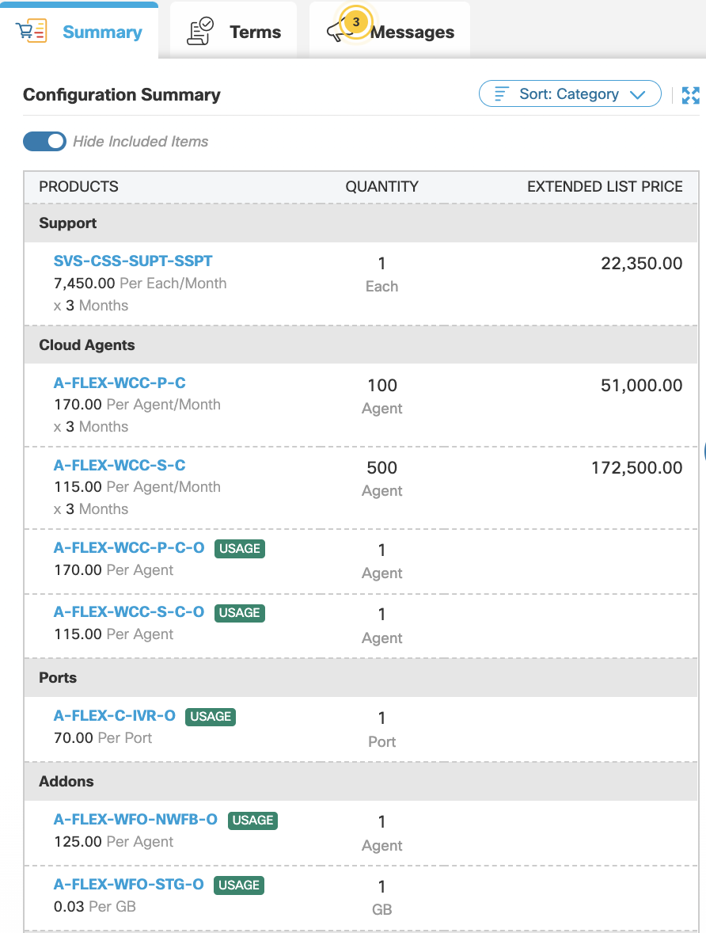
Overages
Overage SKUs added to every order
Billed monthly in arrears

Slide 39
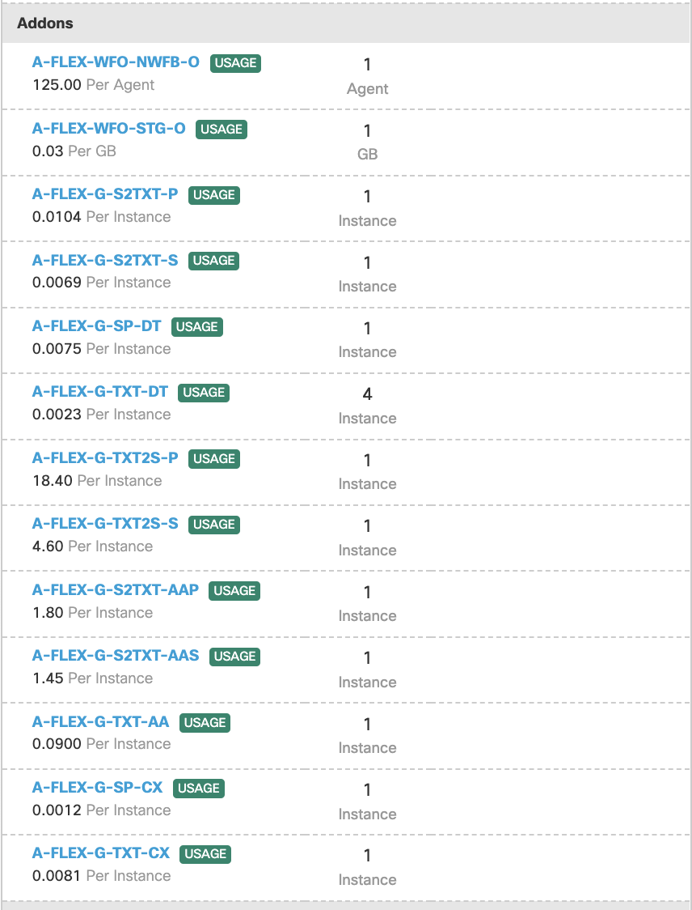
Google CCAI
Dialogflow ES and Dialogflow CX SKUs added to every order
Billed monthly in arrears

Slide 40
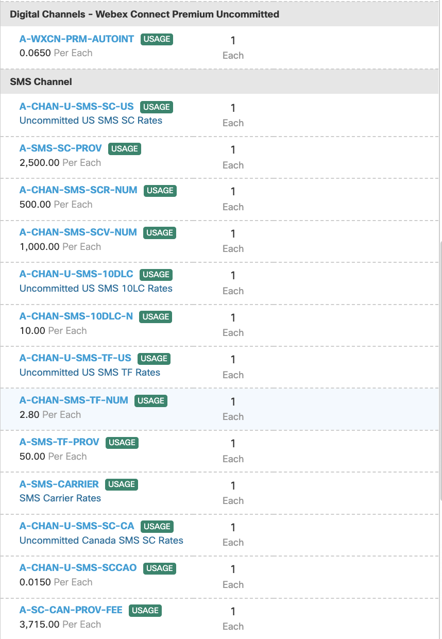
Digital Channels
Webex Connect Premium Uncommitted SKUs added to every order
Billed monthly in arrears

Slide 41
Order Booked – What’s Left?

Slide 42
Ordering to Ship – Process Flow
Order is provisioned - If RSD is past
SO Hold Release Request submitted
A2Q requirements are met by the Partner
Order awaiting RSD
Partner submits an order in CCW with Requested Start Date (RSD)
RSD
Step 1
Step 2
Step 3
Step 4
Step 5
Order goes on Pre-subscription hold
Pre-subscription hold is removed
Order is Provisioned
Notes:
The other common myth is its hard to get flex order released. To bust that myth, let me first walk you through the Ordering to Ship process flow.

Slide 43
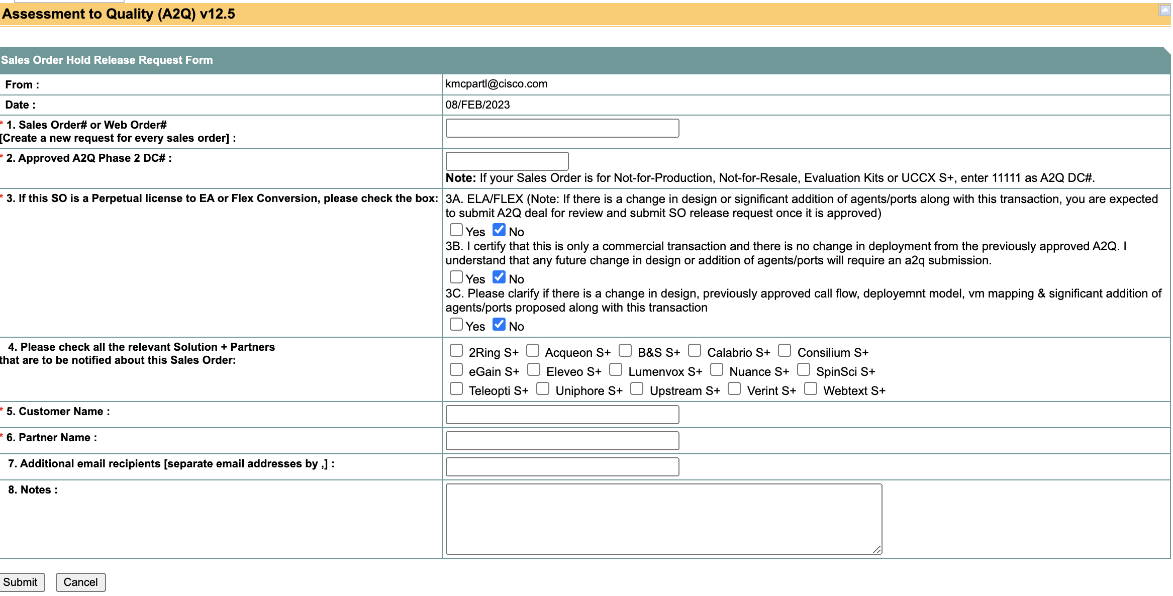
Releasing Flex orders

Slide 44
Specialized Partner – Partner Managed example
Project Manager, Deployment Engineer and other resources identified
Telephony is VPOP
No
Partner
Partner Submits A2Q
Partner Booked Order in CCW
Partner completes discovery, requirement validation and configuration of tenant
Partner delivers Agent, Supervisor and Admin Training
Provision Webex Contact Center
Smartsheet
CCW
Yes
Control Hub
Control Hub
Control Hub
Cisco Reviews and Approves A2Q
A2Q Team removes the order from Hold
CSM will open a Ticket
Cisco
Email
CCW
Jira
CSM is assigned
CSM, Voice Team, Partner and Customer to work on integration
Email
SBC
Customer
Customer sign off on requirement and completes UAT Testing
Customer Identifies resources for Training and schedules time
Go Live
Jira
Virtual

Slide 45
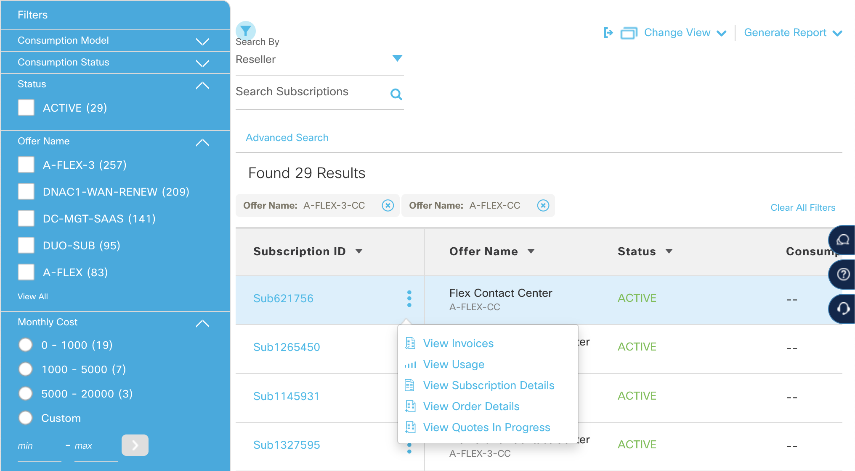
Manage a Subscription
Cisco Commerce Workspace(CCW) is the one stop application to manage your Flex subscription

Slide 46
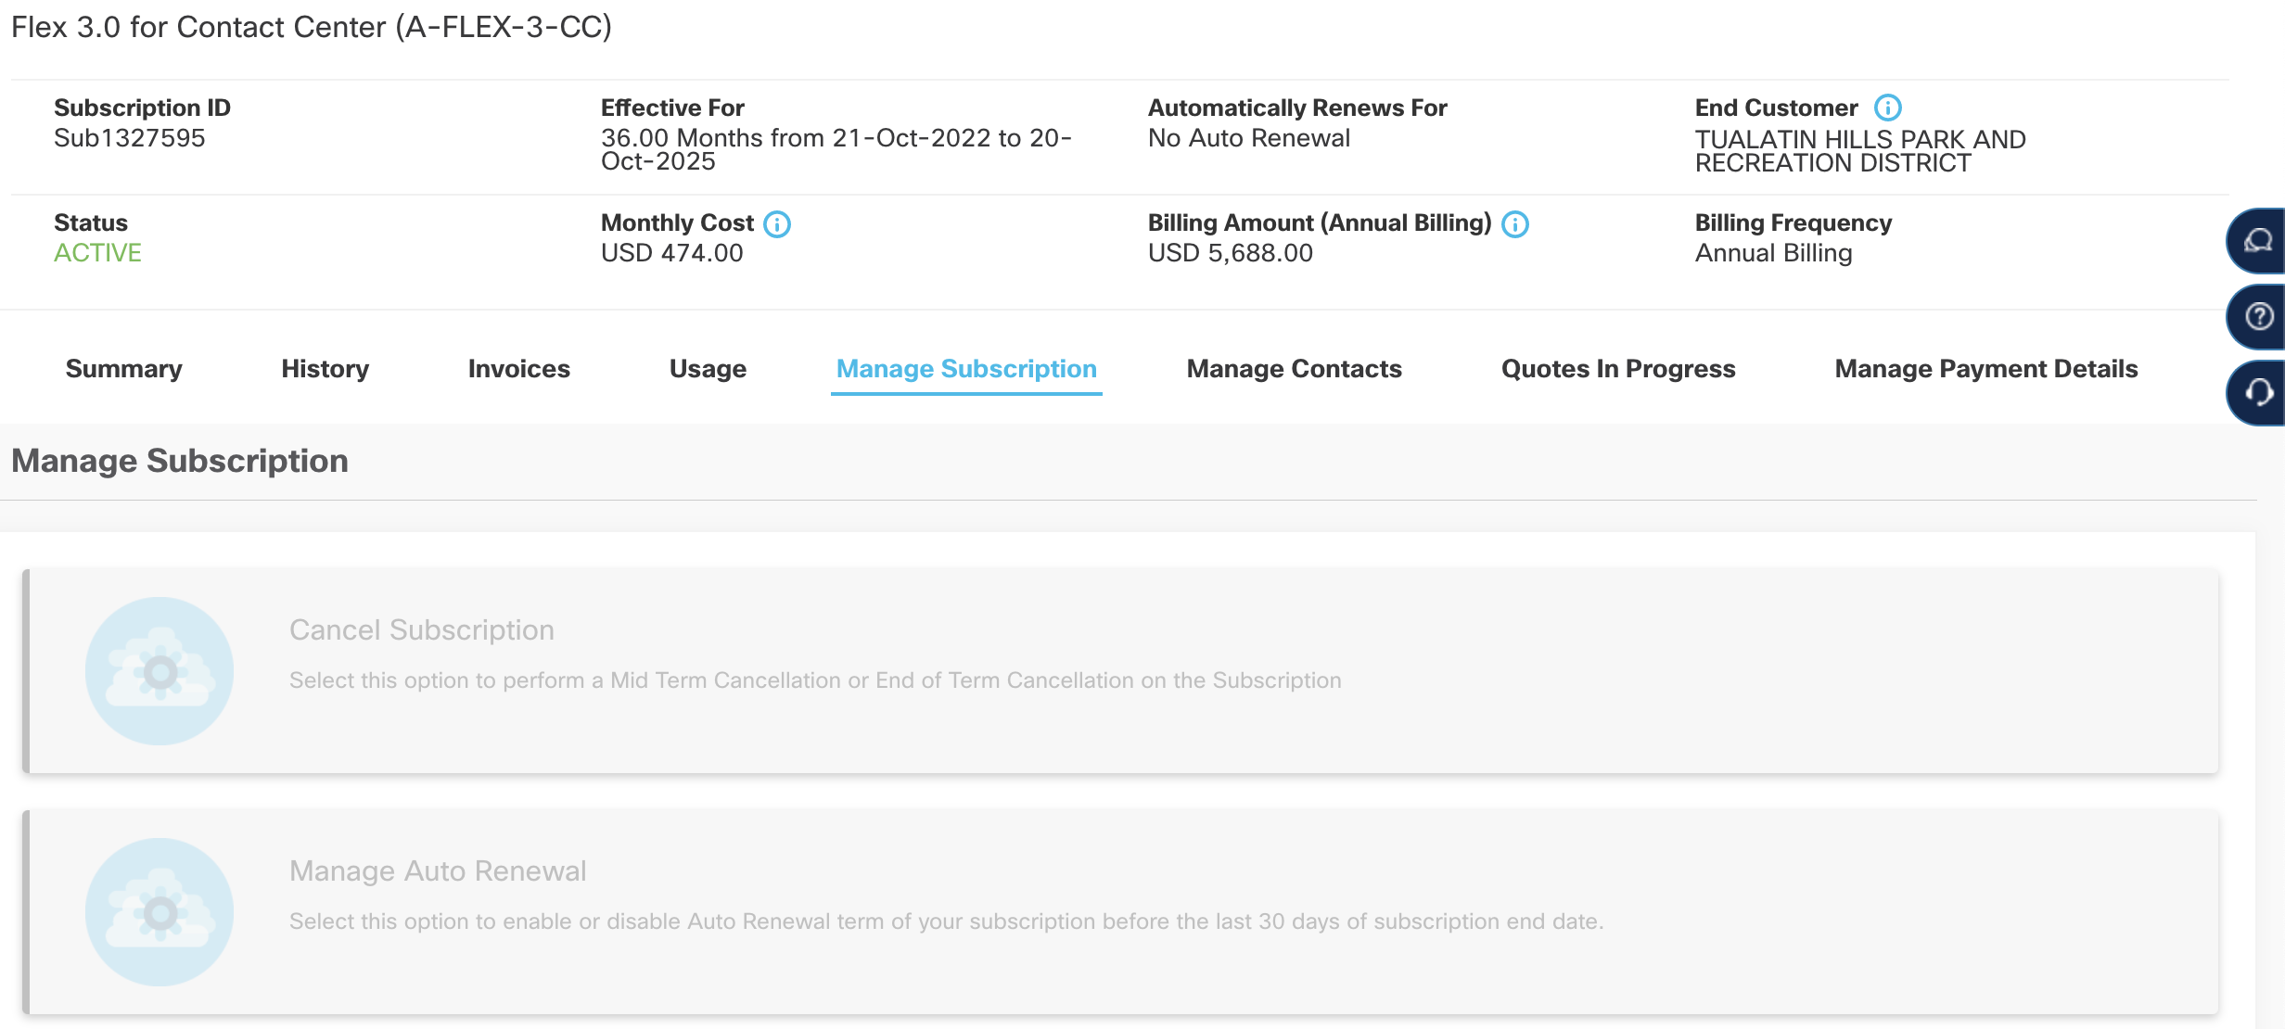
Change–Modify and Change-Replace
Cisco Commerce Workspace(CCW) is the one stop application to manage your Flex subscription

